Slide 1

Lecture 4: Teams, Leadership & Managing People
Learning outcomes:
• Distinguish groups vs teams and diagnose team effectiveness
• Apply core leadership theories to real workplace situations
• Use people-management tools: job design, motivation, performance, rewards, wellbeing
Notes:
[Sources] - https://commons.wikimedia.org/wiki/File:Teamwork_-_Concept_Illustration.jpg (CC BY 2.0) [/Sources]

Slide 2


Overview
2
We will move through three connected lenses:
A. Working in groups & teams
B. Leadership in work organisations
C. Managing people at work
How groups form and perform
Roles, norms, decision-making
Conflict, cohesion, and inclusion
What leadership is (and isn’t)
Key theories & when to use them
Power, influence, and ethics
Job design & motivation
Performance & feedback systems
Rewards, wellbeing, relations
Give an example of a team you ’ve been in and keep it as a running case across the deck.
Notes:
[Sources] - https://commons.wikimedia.org/wiki/File:Teamwork_-_Concept_Illustration.jpg - https://commons.wikimedia.org/wiki/File:Leadership_-_The_Noun_Project.svg (preview PNG; CC0) - https://commons.wikimedia.org/wiki/File:Human_resources.png (CC0) [/Sources]

Slide 3
Groups vs Teams: Core distinctions
3
A practical distinction:
GROUP
TEAM
Individuals coordinate (sometimes loosely)
Accountability mainly individual
Outputs are aggregated (sum of parts)
May share information, resources, norms
Example: people in the same department
Interdependence is designed-in (shared tasks)
Mutual accountability and shared goals
Synergy possible (whole > sum of parts)
Roles are complementary (coordination is explicit)
Example: product squad delivering a feature
Discussion: Think of one “group” you belong to that would perform better if redesigned as a “team”. What would need to change?
Notes:
[Sources] - https://hr.mit.edu/learning-topics/teams/articles/stages-development (teamwork concepts for group development context) [/Sources]

Slide 4
Why organisations use teams (and when they backfire)
4
Teams are not “automatically better” — they are a design choice.
Potential benefits
Common risks
Broader skill mix → better problem solving
Faster learning and knowledge sharing
More commitment when people co-create goals
Improved coordination across functions
Resilience: coverage when someone is absent
Coordination cost (meetings, handoffs)
Social loafing / unclear accountability
Groupthink: premature consensus
Conflict escalation (task → relationship)
Inequity perceptions (effort vs rewards)
Notes:
[Sources] - https://www.jstor.org/stable/pdf/3791464.pdf (groupthink concept referencing Janis) - https://web.mit.edu/curhan/www/docs/Articles/15341_Readings/Group_Dynamics/required_reading/4Latane_et_al_1979_Many_hands_make_light_the_work.pdf (social loafing evidence) [/Sources]

Slide 5
Common team types (and typical challenges)
5
Teams differ in purpose, duration, boundaries, and degree of autonomy.
Functional / operational
Cross-functional / project
Self-managed / autonomous
Stable, within one function
Risk: silos, local optimisation
Temporary or product-based
Risk: role ambiguity, conflict
High discretion
Risk: coordination with wider org
Virtual / distributed
Leadership / top team
Communities of practice
Work across locations/time zones
Risk: trust + communication gaps
Sets direction and allocates resources
Risk: politics, groupthink
Learning & knowledge sharing
Risk: low priority, weak sponsorship
Mini-activity: Pick one team type and list 2 “design choices” you would make to reduce its typical risks.

Slide 6
How teams develop: Tuckman’s stages (diagnostic lens)
6
Use stages as a map, not a rigid script — teams can move back and forth.
Forming
Storming
Norming
Performing
Adjourning
Orientation, uncertainty
Need: purpose + roles
Conflict, testing norms
Need: facilitation + clarity
Shared rules & trust
Need: commitment + feedback
High interdependence
Need: autonomy + support
Closure / transition
Need: review + learning
What would you see and hear?” at each stage (behaviours, language, meeting patterns). Then discuss the leader’s actions
Notes:
[Sources] - https://en.wikipedia.org/wiki/Tuckman%27s_stages_of_group_development (background + original 1965 attribution) - https://hr.mit.edu/learning-topics/teams/articles/stages-development (applied description of stages) [/Sources]

Slide 7
Team roles: balancing contributions (Belbin)
7
A “role” is a tendency in how people contribute — not a fixed personality label.
Plant
How to use role thinking
Specialist
Resource
Investigator
Staff the mix needed for the task (not clones)
Spot gaps (e.g., no “finisher”) and mitigate with process
Avoid stereotyping — people flex by context and skill
Agree “team norms” that protect weaker roles
Completer
Finisher
Co-ordinator
Balance
& fit
Implementer
Shaper
Teamworker
Monitor
Evaluator
Quick exercise: Have learners map their last team onto these roles. Where were the overloads/gaps? What problems did that create?
Notes:
[Sources] - https://www.belbin.com/resources/faqs (list of nine roles) - https://link.springer.com/chapter/10.1007/978-1-349-91440-1_6 (Belbin 1981 referenced) [/Sources]

Slide 8
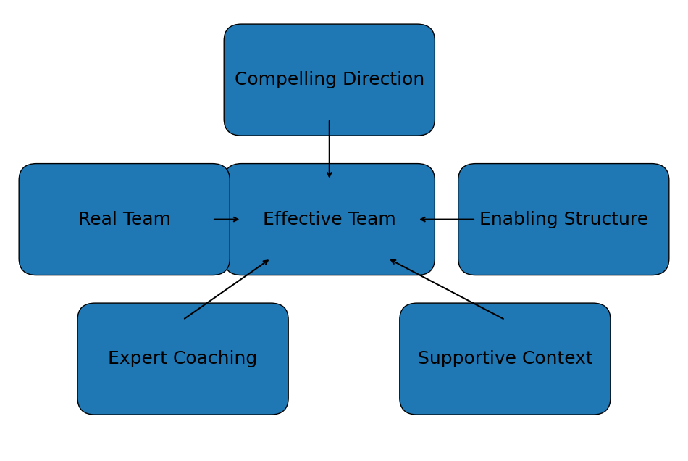
Designing for team effectiveness: Hackman’s conditions
8
Hackman argues team performance depends heavily on the conditions leaders set, not constant micromanagement.
Checklist question: Which condition is weakest right now?
→ Fix the system first (direction, structure, resources), then coach behaviour.
Notes:
[Sources] - https://umbrex.com/resources/frameworks/organization-frameworks/hackman-five-conditions-for-team-effectiveness/ (five conditions summary) - https://emperform.co.uk/blog/the-hackman-model-of-team-effectiveness-explained/ (book attribution to Hackman, 2002) [/Sources]

Slide 9
Decision-making in groups: quality vs speed
9
Good process prevents predictable failure modes.
Useful methods (choose to fit the decision)
Watch for Groupthink
Brainstorm + converge (separate idea gen from evaluation)
Nominal group technique (individual write-up → structured sharing)
Delphi (iterative anonymous expert input for complex issues)
Decision rules (consensus, majority, leader decides) — state upfront
Pressure for unanimity; dissent is punished or self-censored
Illusion of invulnerability (“we can’t be wrong”)
Rationalising away warning signals
Stereotyping outsiders / critics
Poor contingency planning
Tip: Use “pre-mortems” and “red teams” for high-stakes decisions.
Notes:
[Sources] - https://web.mit.edu/curhan/www/docs/Articles/15341_Readings/Group_Dynamics/Janis_Groupthink.pdf (Janis groupthink summary & symptoms) - https://www.amazon.com/Victims-groupthink-psychological-foreign-policy-decisions/dp/0395140021 (publication details for Janis, 1972) [/Sources]

Slide 10
Communication in teams (especially virtual)
10
Communication problems are rarely “just interpersonal” — they are often structural.
Less rich / more ambiguous
More rich / more nuanced
Docs
Chat
Email
Audio
Video
In-person
Practices that reduce friction
Common virtual-team traps
Single “source of truth” (shared docs + decision log)
Explicit meeting norms (agenda, timeboxes, facilitation)
Asynchronous-first where possible; sync for ambiguity
Clarify handoffs: who owns what, by when
Silence = misread as agreement
Time-zone inequity (same people always flex)
Low “context” for new joiners
Harder to build trust without informal contact

Slide 11
Managing conflict: task vs relationship (and your default style)
11
Conflict is not always bad: task conflict can improve decisions; relationship conflict usually harms trust.
Thomas–Kilmann: 2 dimensions
Guiding questions
Assertiveness ↑
Is the issue about ideas (task) or identity (relationship)?
What would “good conflict” look like here?
Do we need speed (decide) or quality (explore)?
What agreements can prevent repeat conflicts (roles, norms, resources)?
Competing
Collaborating
Compromising
Avoiding
Accommodating
Cooperation →
Notes:
[Sources] - https://link.springer.com/article/10.1023/A:1013280109471 (TKI overview in negotiation education) - https://en.wikipedia.org/wiki/Thomas%E2%80%93Kilmann_Conflict_Mode_Instrument (background and five modes) [/Sources]

Slide 12
Cohesion, norms, and social loafing
12
High cohesion can be an asset — but only if aligned to the task and to healthy norms.
Cohesion
Norms
Social loafing
Sense of belonging
Commitment to team goals
More support in stress
Unwritten “rules”
Define acceptable behaviour
Protect quality & safety
Effort drops in groups
Hidden work / unclear contribution
Worse when tasks are additive
Countermeasures to loafing:
• Make contributions visible (task boards, shared metrics)
• Increase task significance and ownership
• Use smaller teams for additive work
• Build fairness: clear expectations + feedback
Notes:
[Sources] - https://web.mit.edu/curhan/www/docs/Articles/15341_Readings/Group_Dynamics/required_reading/4Latane_et_al_1979_Many_hands_make_light_the_work.pdf (social loafing experiments) [/Sources]

Slide 13
Psychological safety: enabling learning and speaking up
13
Psychological safety: A shared belief that the team is safe for interpersonal risk-taking (e.g., questions, dissent, admitting mistakes). Leader behaviours that create psychological safety are as follows:
Frame work as learning
Model fallibility
Complex tasks need experiments, not perfection.
Leaders admit uncertainty and mistakes first.
Invite participation
Respond productively
Use rounds, questions, and quiet-first methods.
Thank, explore, and act — don’t punish messengers.
Reflection: When was the last time you held back a concern at work? Which of the four practices would have helped?
Notes:
[Sources] - https://journals.sagepub.com/doi/10.2307/2666999 (Edmondson, 1999 psychological safety definition) - https://web.mit.edu/curhan/www/docs/Articles/15341_Readings/Group_Performance/Edmondson%20Psychological%20safety.pdf (PDF copy of Edmondson 1999) [/Sources]

Slide 14
Leadership in work organisations
How leaders influence direction, motivation, and culture
14
Notes:
[Sources] - https://commons.wikimedia.org/wiki/File:Leadership_-_The_Noun_Project.svg (preview PNG; CC0) [/Sources]

Slide 15
Leadership vs Management (complementary, not rivals)
15
In practice, most roles require a blend — but the emphasis shifts by level and context.
MANAGEMENT (stability)
LEADERSHIP (change)
Plans & budgets
Sets direction & vision
Organises & staffs
Aligns people to purpose
Controls & solves problems
Motivates & inspires
Builds reliable processes
Shapes culture and meaning
Focus: efficiency
Focus: effectiveness
Prompt: In your organisation, where is leadership most needed right now
— direction, alignment, or motivation?

Slide 16
Leadership capabilities: skills + emotional intelligence
16
Two useful lenses:
Katz: 3-skill approach
Emotional intelligence (EI)
Technical skill: knowing methods/tools (important early-career)
Human skill: working with people (important at every level)
Conceptual skill: systems thinking, strategy (rises with seniority)
Self-awareness: recognise emotions and triggers
Self-regulation: manage reactions under pressure
Empathy: read others’ perspectives and needs
Social skill: influence, listen, build trust
Motivation: persistence and purpose
Practical implication
Promotion without skill-shifts can create “accidental managers”. Build people skills early; build systems thinking deliberately.
Micro-skill: In 1:1s, ask “What’s making this hard right now?” then mirror and summarise before problem-solving.
Notes:
[Sources] - https://www.f5fp.com/wp-content/uploads/2015/01/HBR-Classic-Skills-of-an-Effective-Administrator-Katz.pdf (Katz skills model) - https://pubmed.ncbi.nlm.nih.gov/10187249/ (Goleman, 1998 EI and leadership) [/Sources]

Slide 17
Behavioural leadership: what leaders *do* (and trade-offs)
17
Behavioural theories focus on observable actions: concern for task vs concern for people.
Blake & Mouton grid (simplified)
Concern for people ↑
How to use the grid in practice
Country club
(1,9)
Team
(9,9)
Treat as a conversation tool (not a personality test)
Ask: What does the situation require (task demands + people needs)?
Notice your “default” under stress (e.g., authority vs accommodation)
Build range: practice behaviours you underuse
Middle
(5,5)
Impoverished
(1,1)
Authority
(9,1)
Application: For a current challenge, plot your behaviour today and your target behaviour. What one action would shift the point?
Concern for production →
Notes:
[Sources] - https://www.symlog.com/resources/blake-mouton (grid description and axes) [/Sources]

Slide 18
Contingency thinking: matching style to situation (Fiedler)
18
Core idea: leadership effectiveness depends on the fit between a leader’s style and situational “favourableness”.
Assess situational favourableness
Style fit (simplified)
Leader–member relations (trust, respect)
Task structure (clarity of goals, methods, standards)
Position power (formal authority, control of rewards)
Task-oriented leaders tend to perform best in very favourable or very unfavourable situations; relationship-oriented leaders in mid-range situations (classic interpretation).
Task
style
Relationship
style
Low
High
Implication
Situational favourableness
If style is relatively stable, change the situation (structure, authority, relationships) or change the role/leader.
Notes:
[Sources] - https://www.sciencedirect.com/science/article/abs/pii/0030507367900232 (empirical test referencing Fiedler contingency model) - https://www.econbiz.de/Record/the-contingency-model-new-direction-for-leadership-utilization-fiedler-fred/10002149876 (bibliographic reference to Fiedler, 1967) [/Sources]

Slide 19
Situational leadership: adapting task & support
19
Core idea: adjust the balance of directive (task) and supportive (relationship) behaviour to follower development for a specific task.
Leadership behaviour (2×2)
How to apply
Support ↑
Supporting
(low dir, high sup)
Coaching
(high dir, high sup)
Diagnose *task-specific* ability + commitment
Start with more direction when risk is high
Reduce direction as competence grows
Keep support high when confidence dips
Re-diagnose when tasks change
Delegating
(low dir, low sup)
Directing
(high dir, low sup)
Caution: “Adapt style” is useful advice — but evidence on specific prescriptions is mixed. Use as a coaching heuristic, not a rulebook.
Direction →
Notes:
[Sources] - https://www.sciencedirect.com/science/article/pii/S104898439790014X (critical review citing Hersey & Blanchard 1969/1970s evolution) - https://www.ebsco.com/research-starters/social-sciences-and-humanities/situational-leadership-theory (overview of style–maturity alignment) [/Sources]

Slide 20
Path–Goal theory (House): removing obstacles to performance
20
Leader’s job: clarify goals, clarify the “path”, and increase motivation by aligning rewards with performance.
Leader behaviours (choose to fit follower + task)
Example applications
Directive: clarify roles, standards, steps (helpful when tasks are ambiguous)
Supportive: build confidence, reduce stress (helpful in demanding contexts)
Participative: involve people in decisions (helps commitment and quality)
Achievement-oriented: set stretch goals and show confidence
New joiner: more directive + supportive
Expert team: participative + achievement-oriented
High stress period: supportive + clear priorities
Cross-functional ambiguity: directive + participative (co-create process)
What is blocking performance right now — unclear goals, low capability, low motivation, poor resources, or conflicting priorities?
Notes:
[Sources] - https://www.jstor.org/stable/pdf/2391905 (House, 1971 original article) - https://www.scirp.org/reference/referencespapers?referenceid=3007294 (citation details and DOI) [/Sources]

Slide 21
Leader–Member Exchange (LMX): quality of relationships
21
LMX focuses on the relationship quality between leader and each follower, not “one style fits all”.
Stranger
Acquaintance
Leader actions to raise LMX fairly
Partner
Low trust
Role-based exchanges
Testing
More mutual support
High trust
Mutual influence
Use consistent 1:1 rhythms with everyone
Give transparent criteria for opportunities
Share information broadly (avoid “inner circle” dynamics)
Invest in feedback + development for all team members
Risk: “in-groups” vs “out-groups”
Differentiated relationships can look like favouritism
Unequal access to information and opportunity harms trust
Perceived unfairness reduces motivation and increases conflict
Notes:
[Sources] - https://www.sciencedirect.com/science/article/pii/1048984395900365 (Graen & Uhl-Bien, 1995 LMX theory article) - https://www.scirp.org/reference/referencespapers?referenceid=1143589 (citation details and DOI) [/Sources]

Slide 22
Power and influence: French & Raven’s bases
22
Power is the capacity to influence outcomes; influence is the process of changing attitudes/behaviour.
Legitimate
Reward
Coercive
Expert
Referent
Role authority
Control of benefits
Ability to punish
Credibility/skill
Respect/identification
Ethical principle:
Prefer “expert” and “referent” influence; use coercion sparingly and transparently (risk: fear, silence, cynicism).
Notes:
[Sources] - https://www.scirp.org/reference/referencespapers?referenceid=2745603 (French & Raven, 1959 citation details) - https://www.ebsco.com/research-starters/social-sciences-and-humanities/french-and-ravens-bases-power (overview of bases of power) [/Sources]

Slide 23
Transformational leadership & developing leaders
23
Transformational: the “Four I’s”
Developing leaders (practical)
Idealised influence (role model, integrity)
Inspirational motivation (vision + meaning)
Intellectual stimulation (challenge + learning)
Individualised consideration (coaching, growth)
Use stretch assignments with real support
Coach specific behaviours (not “be more confident”)
Feedback loops: peers, team, customers
Mentoring + role modelling
Reflective practice (after-action reviews)
Ethical guardrails
A compelling vision must still respect fairness, voice, and psychological safety — charisma without ethics can become manipulation.
Notes:
[Sources] - https://www.regent.edu/journal/emerging-leadership-journeys/transformational-leadership-the-impact-on-organizational-and-personal-outcomes/ (Bass 1985 summary) - https://www.businessballs.com/leadership-styles/four-is-transformational-leadership/ (Four I’s list) [/Sources]

Slide 24
Managing people at work
Designing jobs, motivation systems, performance, rewards, and wellbeing
24
Notes:
[Sources] - https://commons.wikimedia.org/wiki/File:Human_resources.png (CC0) [/Sources]

Slide 25
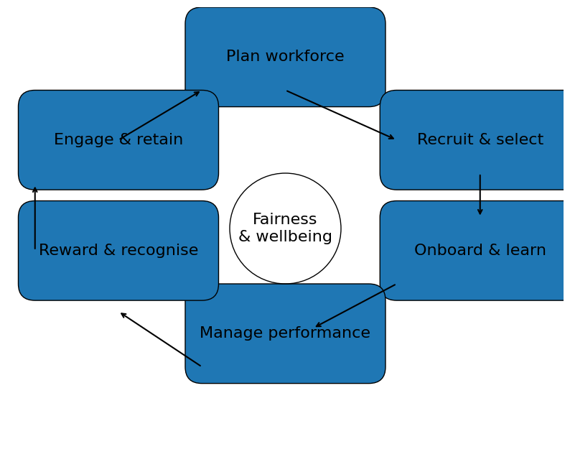
People management as a system (HRM cycle)
25
Think end-to-end: attract → develop → perform → reward → retain (with fairness throughout).
Manager’s role in the cycle
Translate strategy into clear roles and priorities
Build capability (coaching + learning opportunities)
Set expectations and give frequent feedback
Make rewards meaningful and fair
Protect wellbeing and psychological safety

Slide 26
Job design: Job Characteristics Model (Hackman & Oldham)
26
Well-designed jobs can increase intrinsic motivation by shaping core psychological states.
5 core characteristics
3 psychological states → outcomes
Skill variety
Task identity
Task significance
Autonomy
Feedback
Meaningfulness of work
Responsibility for outcomes
Knowledge of results
→ Higher motivation, satisfaction, performance; lower turnover/absences
Job redesign ideas: combine tasks, increase customer contact, rotate roles, give decision rights, build faster feedback loops.
Notes:
[Sources] - https://web.mit.edu/curhan/www/docs/Articles/15341_Readings/Group_Performance/Hackman_et_al_1976_Motivation_thru_the_design_of_work.pdf (Hackman & Oldham, 1976) - https://en.wikipedia.org/wiki/Job_characteristic_theory (summary of five characteristics and three psychological states) [/Sources]

Slide 27
Motivation (content theories): what people need/want
27
Content theories focus on needs and the factors that create satisfaction or dissatisfaction.
Maslow (1943)
Herzberg (1959)
McClelland (1961)
Hierarchy of needs (simplified):
• Physiological
• Safety
• Belonging
• Esteem
• Self-actualisation
Two-factor theory:
• Hygiene factors prevent dissatisfaction
(pay, policy, conditions)
• Motivators create satisfaction
(achievement, recognition, growth)
Three learned needs:
• Achievement
• Affiliation
• Power
Practical: tailor roles/rewards to dominant needs.
Teaching note: Use these as lenses for *hypotheses* about motivation; validate with the person (don’t assume).
Notes:
[Sources] - https://psychclassics.yorku.ca/Maslow/motivation.htm (Maslow, 1943 original paper) - https://www.scirp.org/reference/referencespapers?referenceid=2481540 (Herzberg, 1959 book citation) - https://www.sciencedirect.com/science/article/pii/S2451958825001617 (references McClelland, 1961) [/Sources]

Slide 28
Motivation (process theories): expectations, fairness, goals
28
Process theories explain *how* motivation happens (cognition and perceived fairness).
Expectancy (Vroom)
Equity (Adams)
Goal-setting (Locke & Latham)
Effort → performance (expectancy)
Performance → outcomes (instrumentality)
Value of outcomes (valence)
Fix by: capability, resources, clear link to rewards
People compare inputs/outcomes to others
Perceived inequity drives tension and withdrawal
Fix by: transparency, consistent standards, voice
Specific & challenging goals improve performance
Needs commitment + feedback
Use SMART objectives as a practical tool
Notes:
[Sources] - https://books.google.com/books/about/Work_and_Motivation.html?id=kexEAAAAIAAJ (Vroom, 1964 book record) - https://www.sciencedirect.com/science/chapter/bookseries/pii/S0065260108601082 (Adams equity theory references and related publications) - https://pubmed.ncbi.nlm.nih.gov/12237980/ (Locke & Latham, 2002 goal-setting theory review) - https://en.wikipedia.org/wiki/SMART_criteria (Doran, 1981 SMART origins overview) [/Sources]

Slide 29
Performance management: expectations, feedback, and bias
29
Performance management works best as a continuous loop, not a once-a-year event.
Coach
& support
Common
rater errors
Set
expectations
Review
progress
• Halo/horns
• Leniency
• Central tendency
• Recency
Develop
& reward
Reduce bias by:
• using evidence
• calibration
• clear criteria
• multiple inputs
Practice: Draft one SMART objective + 2 behavioural indicators. Then write a feedback sentence using SBI (Situation–Behaviour–Impact).
Notes:
[Sources] - https://www.dartmouth.edu/hr/professional_development/for_managers/performance_management/common_rater_errors.php (definitions of halo, leniency, central tendency) - https://en.wikipedia.org/wiki/SMART_criteria (SMART origin and criteria overview) [/Sources]

Slide 30
Rewards, engagement, and wellbeing: sustaining performance
30
People systems should attract, retain, and energise — while preventing chronic stress and burnout.
Total rewards (portfolio view)
Wellbeing and burnout
Compensation and benefits
Recognition (timely, specific)
Career growth and development
Well-being supports
Meaningful work + fair management
WHO: burnout is an occupational phenomenon from chronic workplace stress not successfully managed
3 dimensions: exhaustion; mental distance/cynicism; reduced efficacy
Primary levers are systemic: workload, control, community, fairness, values
Manager actions: prioritise, remove low-value work, resource properly, build safety and support
Rule of thumb: Pay needs to be fair and understood; motivation is sustained more by growth, autonomy, and respect than by money alone.
Close: Revisit your running case team. Which 2 interventions would you prioritise next week (team design, leadership behaviour, or people system)?
Notes:
[Sources] - https://go.worldatwork.org/rs/935-UZU-718/images/WorldatWork_Unlock_the_Power_of_Total_Rewards_Guide.pdf (Total Rewards definition and elements) - https://www.who.int/standards/classifications/frequently-asked-questions/burn-out-an-occupational-phenomenon (WHO burnout definition in ICD-11) [/Sources]

Slide 31
References
Buchanan, D. and Huczynski, A. (2023) Organizational Behaviour, 11th edition, Harlow: Pearson Education Limited (Essential reading)
Mullins, L. J. and Rees, G. (2023) Management and organisational behaviour, 13th edition, Harlow: Pearson.

Slide 32
ANY QUESTIONS?

